Slide 1
INTRODUCTION TO PYTHON & ENVIRONMENT SET UP

Slide 2
Agenda
What is python
Characteristics of python
Features
Who uses python
Releases
Installation and path set up
Comments in python
Python IDLE

Slide 3
What is Python
Python is a powerful high-level, object-oriented programming language created by Guido van Rossum, released in 1991.
It has simple easy-to-use syntax, making it the perfect language for someone trying to learn computer programming for the first time.

Slide 4
Continue…
Multi-purpose (Web, GUI, Scripting, etc.)
Object Oriented
Interpreted
Strongly typed and Dynamically typed
Focus on readability and productivity

Slide 5
Features
A simple language which is easier to learn
Free and open-source
Portability
Extensible and Embeddable
A high-level, interpreted language
Large standard libraries to solve common tasks
Cross Platform
CPython, Jython, Iron Python, PyPy

Slide 6
Who Uses Python
Google
PBS(Public Broadcast Service)
NASA(For Scientific Applications)
the ONION(America’s Finest News Source)

Slide 7
Releases
Created in 1989 by Guido Van Rossum
Python 1.0 released in 1994
Python 2.0 released in 2000
Python 3.0 released in 2008 etc
Python 3.6.3, released in 03 October 2017.

Slide 8
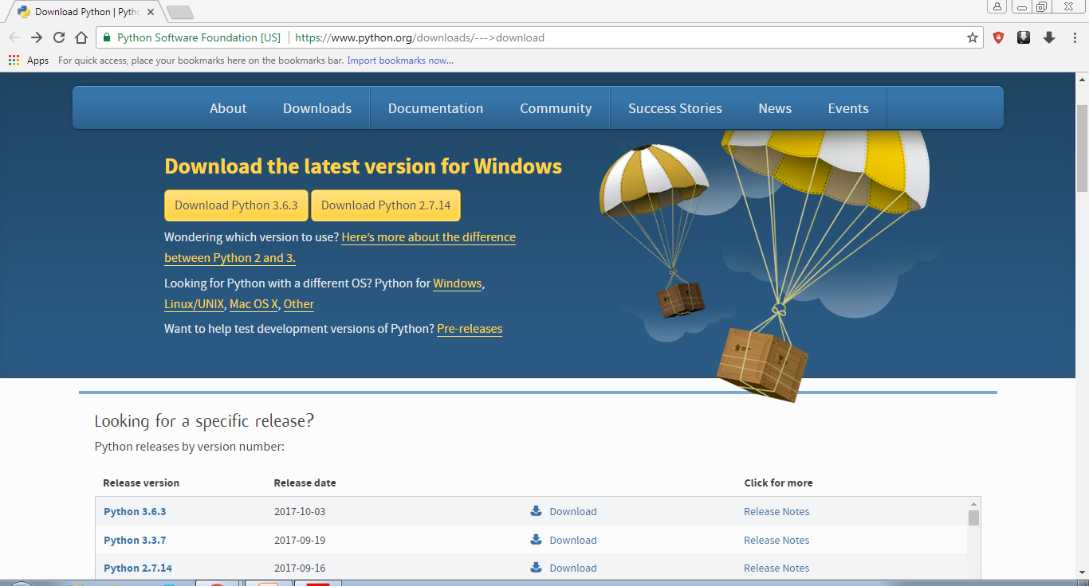
Python Installation
Go Through website https://www.python.org/downloads/
Download exe file of required version

Slide 9
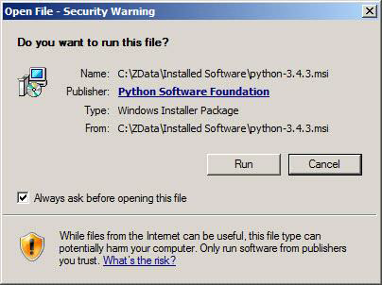
Continue…

Slide 10
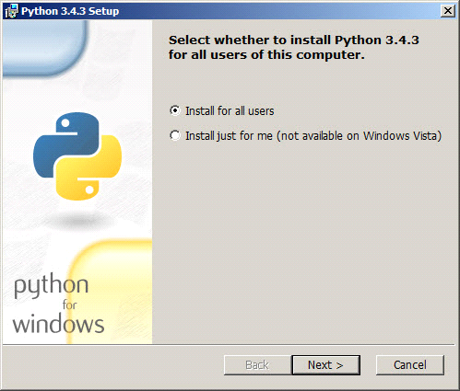
Continue…

Slide 11
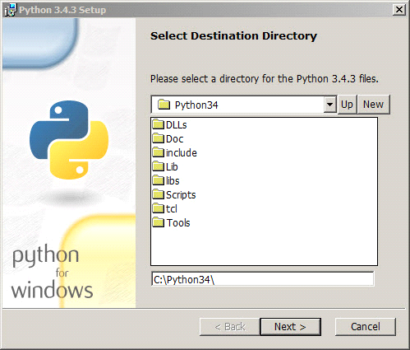
Continue…

Slide 12
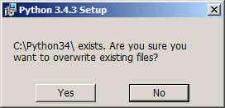
Continue…

Slide 13
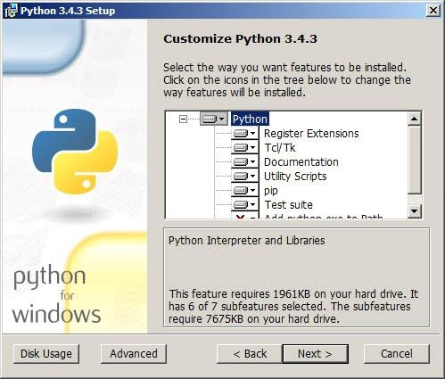
Continue…

Slide 14
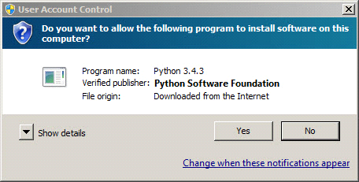
Continue…

Slide 15
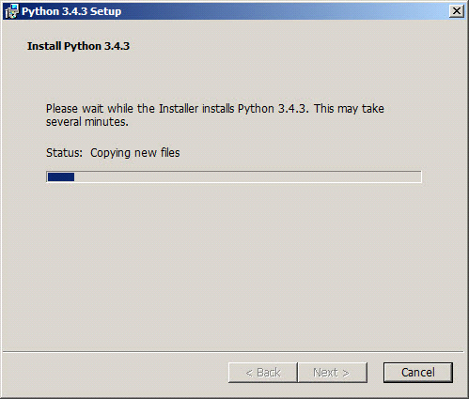
Continue…

Slide 16
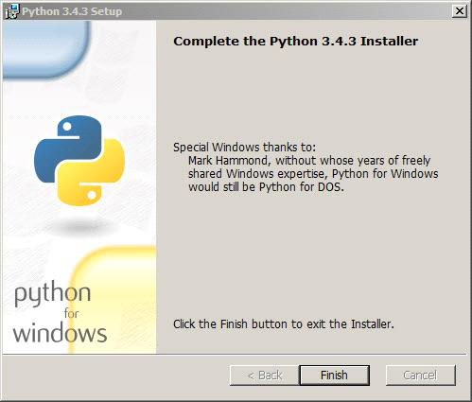
Continue…

Slide 17
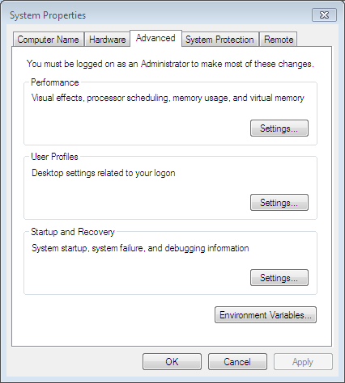
Path Setting for Windows 7
Computers→Properties→Advanced System Settings
Then a pop up window like below will open

Slide 18
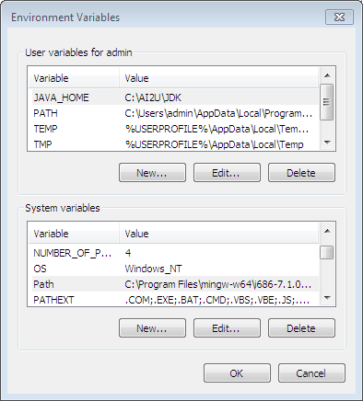
Continue…
Click on Environment variables.
Under System Variables→Select path→Edit

Slide 19
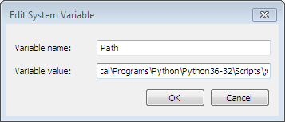
Continue….
Copy the path where python is installed and paste under Edit system variables → variables value and then click ok

Slide 20
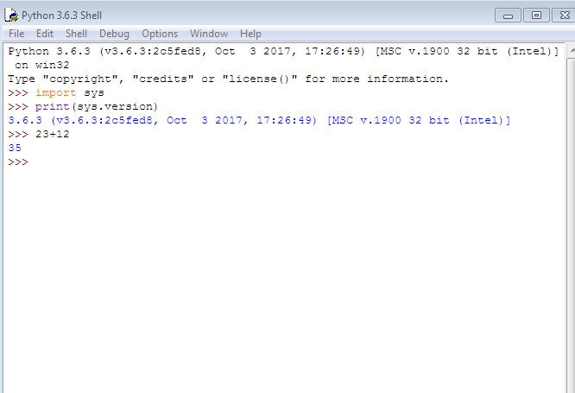
Python Shell or IDLE

Slide 21
Comments
Single-line comments are created simply by beginning a line with the hash (#) character, and they are automatically terminated by the end of line
Comments that span multiple lines – used to explain things in more detail – are created by adding a delimiter (“”) on each end of the comment.
“” ”” This would be a multiline comment

Slide 22
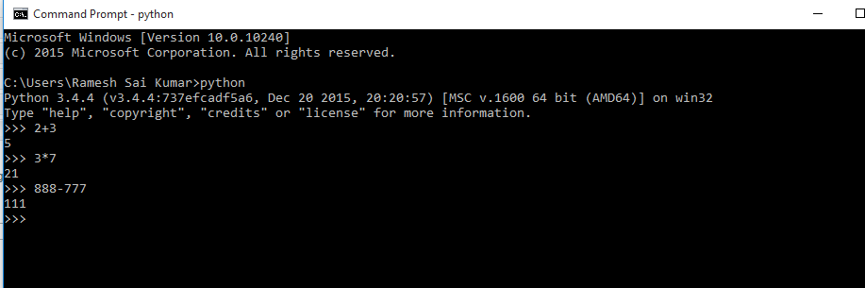
Using command prompt and GUI or IDE, Applications

